Slide 1
CSE 574 Lecture 8: Dynamic Programming
Professor: Stephanie Gil
Email: sgil@asu.edu (Office hours M 12-1pm BYENG 386)
TAs: Sushmita Bhattacharya sbhatt55@asu.edu (Office hours M 5-6 BYENG 392)
Weiying Wang wwang239@asu.edu (Office hours Th 2:30-3:30 BYENG 392)

Slide 2
Pop Quiz Today
This is a closed book quiz. No notes, no phones, no textbook. Please put everything away.
You will have 15 minutes to complete the quiz
Good luck!

Slide 3
Last Time:
Last time: Markov Models and Markov Decision Processes
Reading Sutton and Barto text “Reinforcement Learning, An Introduction” Second Edition (2017), chapter 3 (available online)
This time: Dynamic Programming and Optimal Control Vol 1 (next two lectures)
Chapter 1
Please note that this material is copyrighted and not authorized for sharing or posting outside of this class

Slide 4
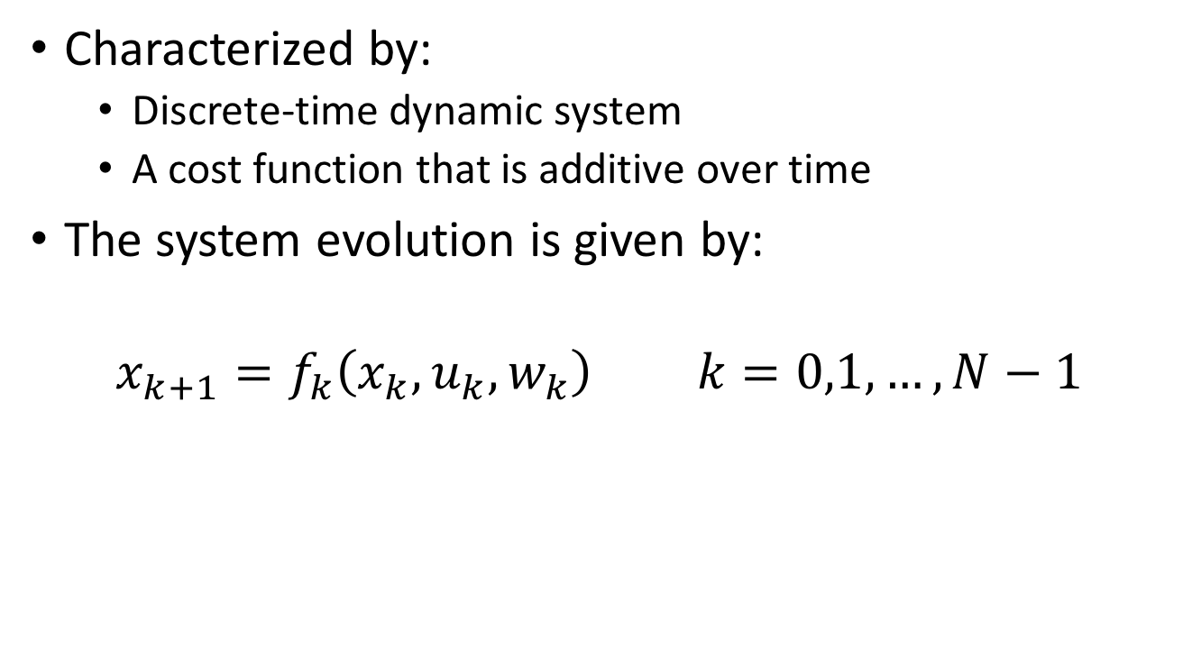
Finite Horizon Decision Problems
Characterized by:
Discrete-time dynamic system
A cost function that is additive over time
The system evolution is given by:
$$x_{k+1}=f_{k}\left(x_{k},u_{k},w_{k}\right) k=0,1,…,N−1$$
Control/decision variable
State of the system: summarizes past information
Noise/disturbance
Discrete time

Slide 5
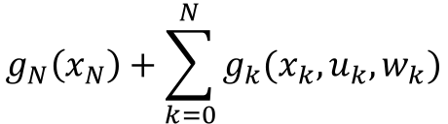
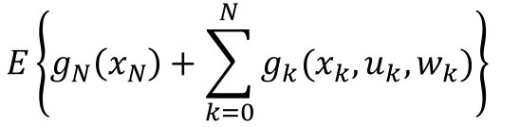
Finite Horizon Decision Problems
Additive cost over time
Expected cost:
This should look very familiar! (Think of last class…) Though this is a more general formulation
$$g_{N}\left(x_{N}\right)+\sum_{k=0}^{N}{g_{k}(x_{k}, u_{k},w_{k})}$$
Terminal cost
$${E\left\{g_{N}\left(x_{N}\right)+\sum_{k=0}^{N}{g_{k}(x_{k}, u_{k},w_{k})}\right\}}_{}$$
Stochasitcity comes in through w term

Slide 6
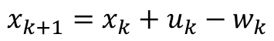
Example: Inventory Control
Scenario: You are the boss at a manufacturing company. You must make strategic decisions about production for this quarter (N finite). Your goals are:
Order enough stock to satisfy (stochastic) demand
Do not order too much stock (holding costs apply)
Your control: i.e. how much stock ordered
$$x_{k+1}=x_{k}+u_{k}−w_{k}$$
Amount of positive stock
Demand (this is stochastic and independent)

Slide 7
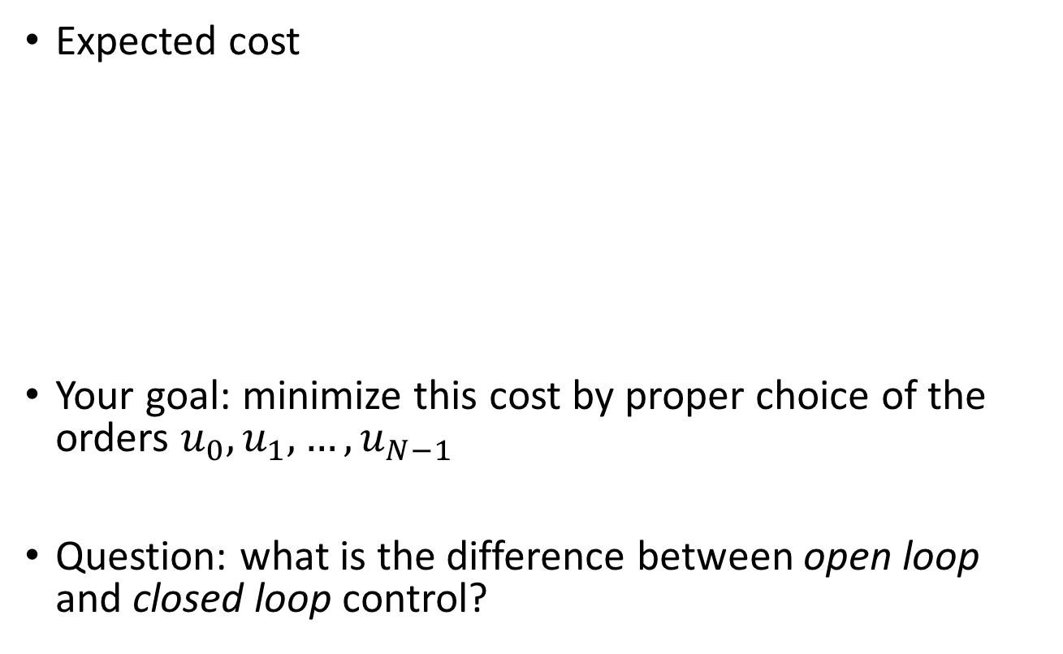
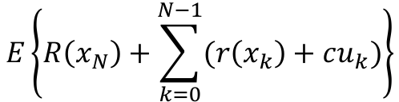
Example: Inventory Control (cont)
Expected cost
Your goal: minimize this cost by proper choice of the orders $u_{0},u_{1},…,u_{N−1}$
Question: what is the difference between open loop and closed loop control?
$$E\left\{R\left(x_{N}\right)+\sum_{k=0}^{N−1}{(r\left(x_{k}\right)+cu_{k})}\right\}$$
Penalty for positive or negative stock
Purchasing cost

Slide 8
Example: Inventory Control (cont)
Fig 1.1.2 in the Bertsekas Optimal Control and Dynamic Programming Vol 1 text

Slide 9
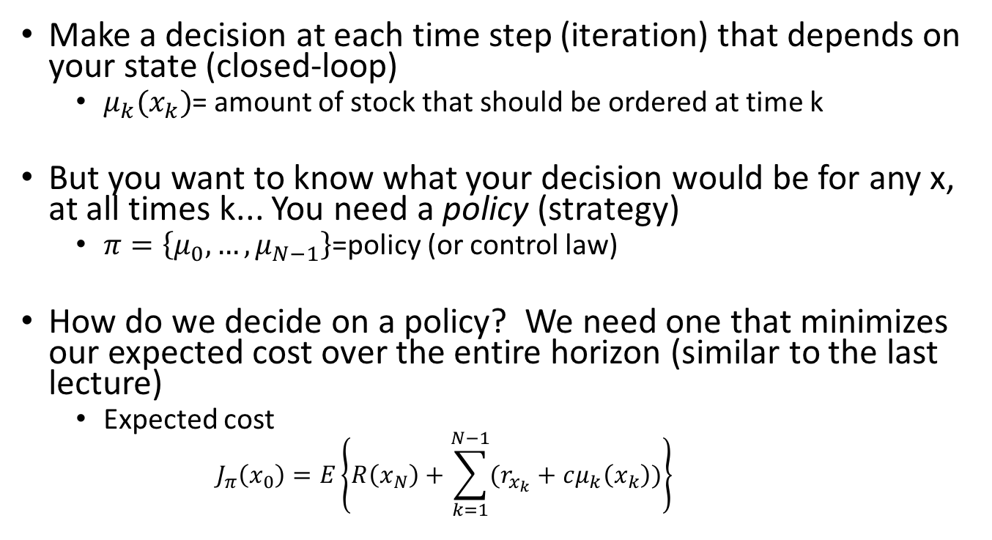
Formulation of the Problem as DP
Make a decision at each time step (iteration) that depends on your state (closed-loop)
$μ_{k}(x_{k})$= amount of stock that should be ordered at time k
But you want to know what your decision would be for any x, at all times k... You need a policy (strategy)
$π=\left\{μ_{0},…,μ_{N−1}\right\}$=policy (or control law)
How do we decide on a policy? We need one that minimizes our expected cost over the entire horizon (similar to the last lecture)
Expected cost
$$J_{π}\left(x_{0}\right)=E\left\{R\left(x_{N}\right)+\sum_{k=1}^{N−1}{(r_{x_{k}}+cμ_{k}\left(x_{k}\right))}\right\}$$
How does this compare to our last lecture?
Minimize this

Slide 10
State Transition Graphs and Control
Some practice in visualizing state transitions
Example: Machine replacement
Fig 1.1.4 in Optimal Control and Dynamic Programming Vol 1 text

Slide 11
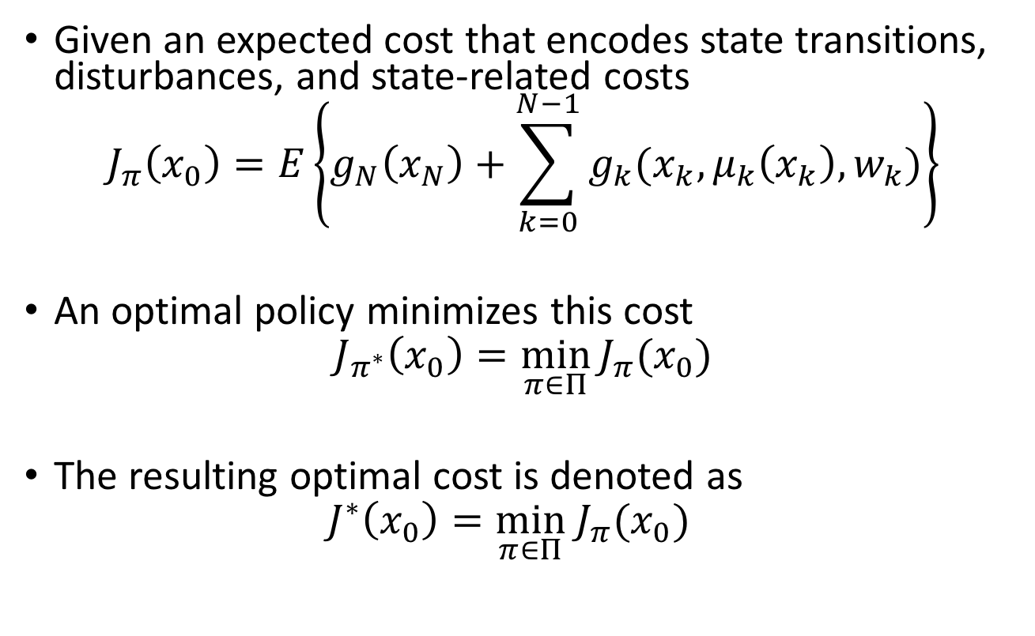
Objective of DP
Given an expected cost that encodes state transitions, disturbances, and state-related costs
$$J_{π}\left(x_{0}\right)=E\left\{g_{N}\left(x_{N}\right)+\sum_{k=0}^{N−1}{g_{k}(x_{k},μ_{k}\left(x_{k}\right),w_{k})}\right\}$$
An optimal policy minimizes this cost
$$J_{π^{∗}}\left(x_{0}\right)=\min_{π∈Π}{J_{π}{(x}_{0})}$$
The resulting optimal cost is denoted as
$$J^{∗}\left(x_{0}\right)=\min_{π∈Π}{ J}_{π}(x_{0})$$
Optimal value function (or cost function)

Slide 12
Comparison to Last Lecture
Environment
Agent
Policy

Slide 13
Open Loop vs. Closed Loop
World Cup!

Slide 14
Open Loop vs. Closed Loop
World Cup!
Rules of the game:
Timid play
Draw with probability p_{d}
Lose with probability (1-p_{d})
Bold play
Win with probability p_{w}
Lose with probability (1-p_{w})
If there is a draw after the second half, sudden death round
Optimal closed-loop strategy:
Play timid if and only if your team is ahead in the score
Bold play versus timid play strategy

Slide 15
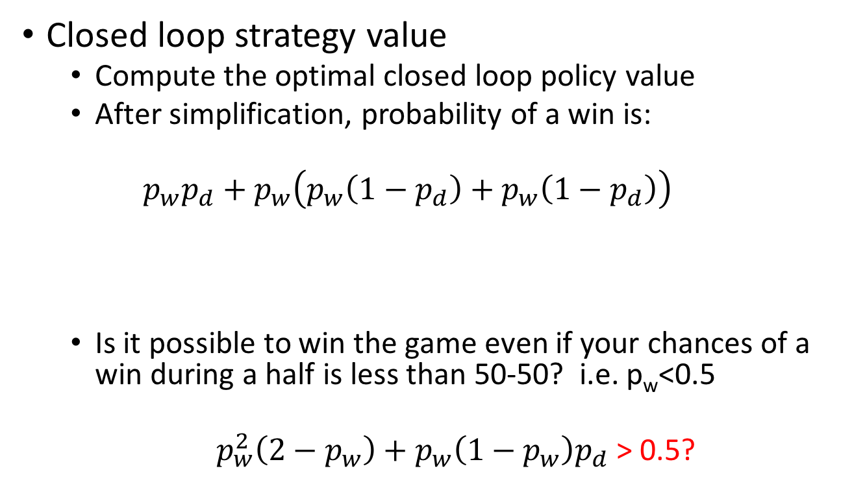
Open Loop vs. Closed Loop
Closed loop strategy value
Compute the optimal closed loop policy value
After simplification, probability of a win is:
$$p_{w}p_{d}+p_{w}\left(p_{w}\left(1−p_{d}\right)+p_{w}\left(1−p_{d}\right)\right)$$
Is it possible to win the game even if your chances of a win during a half is less than 50-50? i.e. p_{w}<0.5
$p_{w}^{2}\left(2−p_{w}\right)+p_{w}\left(1−p_{w}\right)p_{d}$ > 0.5?
Win both halves
Win penalties (sudden death)

Slide 16


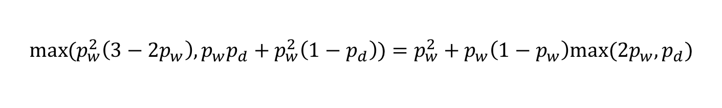

What about Open-loop Strategies?
Cannot exceed 50-50 chances of winning
Timid, Timid
Bold, Bold
Bold, Timid
Timid, Bold
Open-loop probability of a win
Any chance of winning?
$$p_{w}^{2}(3−2p_{w})$$
$$p_{w}p_{d}+p_{w}^{2}(1−p_{d})$$
$$p_{w}p_{d}+p_{w}^{2}(1−p_{d})$$
May depend on who you play…
France?
US?
$$\max{(p_{w}^{2}\left(3−2p_{w}\right), p_{w}p_{d}+p_{w}^{2}\left(1−p_{d}\right))}=p_{w}^{2}+p_{w}\left(1−p_{w}\right)max⁡(2p_{w},p_{d})$$

Slide 17
Value of Information
What if?....
Before the world cup starts: You know you’re playing Germany this world cup
During the world cup: You learned Germany lost to Mexico in their last game and you play them next

Slide 18
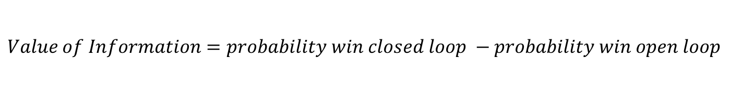
Value of Information (cont)
Value of information for our soccer match
p_{w}=0.45
p_{d}=0.9
The opposing team has a stronger offense
If you put all your guys on defense, your defense is strong
$$Value of Information=probability win closed loop −probability win open loop$$
0.53
0.425

Slide 19
Summary: Open loop vs. Closed Loop
Is information about the current state always valuable when deciding on a policy?
If information is so valuable then the more information the better right? Should I carry around my entire history of states and actions?

Slide 20
Principle of Optimality
The principle behind Dynamic Programming
Section 1.3 Dynamic Programming and Optimal Control Vol 1 Text

Slide 21
Intuitive Explanation
Solve from the last stage iteratively until you have a strategy for the whole route!

Slide 22
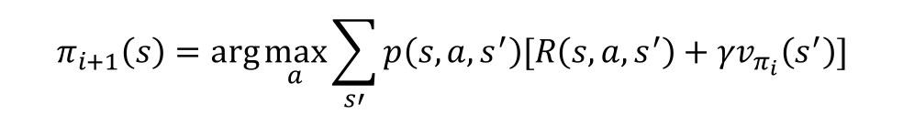
Link to Something We’ve Already Seen
We saw this last time with Bellman’s Equation (recall step 2 of policy iteration)
If the truncated policy was not optimal then would policy iteration improve the policy?
Does PI converge to the optimal policy?
$$π_{i+1}\left(s\right)=\arg{\max_{a}{\sum_{s′}{p\left(s,a,s^{′}\right)[R\left(s,a,s^{′}\right)+γv_{π_{i}}\left(s^{′}\right)]}}}$$

Slide 23
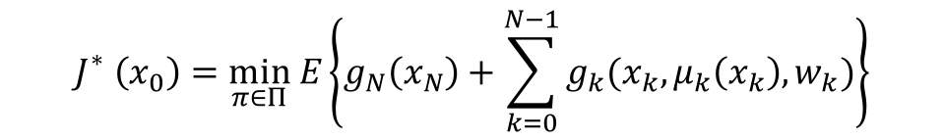
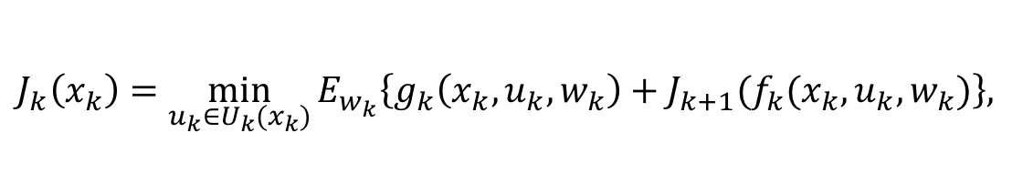
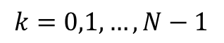
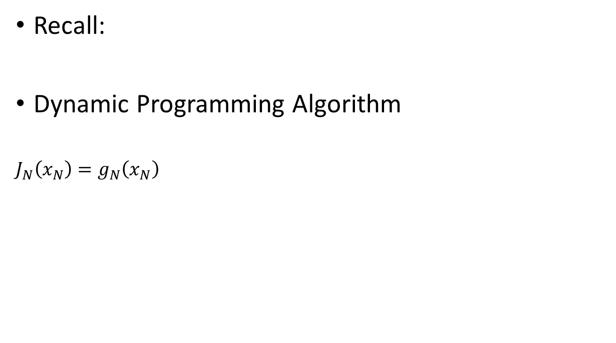
The Dynamic Programming Algorithm
$$J_{}^{∗}\left(x_{0}\right)=\min_{π∈Π} E\left\{g_{N}\left(x_{N}\right)+\sum_{k=0}^{N−1}{g_{k}(x_{k},μ_{k}\left(x_{k}\right),w_{k})}\right\}$$
Recall:
Dynamic Programming Algorithm
$$J_{N}\left(x_{N}\right)=g_{N}\left(x_{N}\right)$$
$$J_{k}\left(x_{k}\right)=\min_{u_{k}∈U_{k}(x_{k})}{E_{w_{k}}\left\{g_{k}\left(x_{k},u_{k},w_{k}\right)+J_{k+1}(f_{k}(x_{k},u_{k},w_{k})\right\}, }$$
$$k=0,1,…,N−1$$

Slide 24
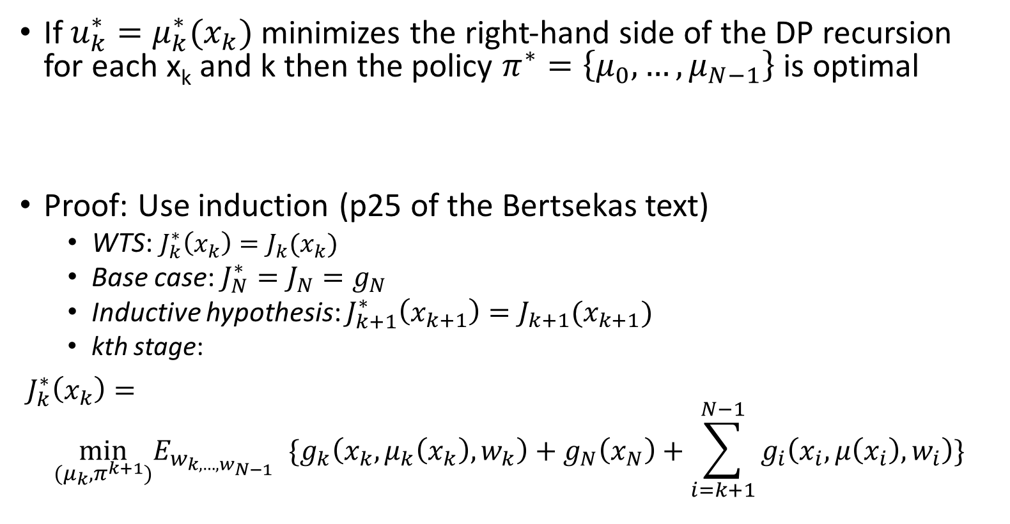
Optimality and the DP Algorithm
If $u_{k}^{∗}=μ_{k}^{∗}(x_{k})$ minimizes the right-hand side of the DP recursion for each x_{k} and k then the policy $π^{∗}=\left\{μ_{0},…,μ_{N−1}\right\}$ is optimal
Proof: Use induction (p25 of the Bertsekas text)
WTS: $J_{k}^{∗}\left(x_{k}\right)=J_{k}(x_{k})$
Base case: $J_{N}^{∗}=J_{N}=g_{N}$
Inductive hypothesis: $J_{k+1}^{∗}\left(x_{k+1}\right)=J_{k+1}(x_{k+1})$
kth stage:
$J_{k}^{∗}\left(x_{k}\right)=$
$$\min_{(μ_{k},π^{k+1})}E_{w_{k,…,w_{N−1}}}{\{g_{k}\left(x_{k},μ_{k}\left(x_{k}\right),w_{k}\right)+g_{N}\left(x_{N}\right)+\sum_{i=k+1}^{N−1}{g_{i}\left(x_{i}, μ\left(x_{i}\right), w_{i}\right)}\}}$$
$$J_{k}\left(x_{k}\right)=\min_{u_{k}∈U_{k}(x_{k})}{E_{w_{k}}\left\{g_{k}\left(x_{k},u_{k},w_{k}\right)+J_{k+1}(f_{k}(x_{k},u_{k},w_{k})\right\}}$$

Slide 25
Inventory Control Problem Revisited
Apply dynamic programming approach to inventory control problem
Fig 1.1.2 in the Bertsekas Optimal Control and Dynamic Programming Vol 1 text

Slide 26
Next Time…
HW 3 is posted (due Sept 28th at 5pm)
Introduction to Dynamic Programming continued
Readings will be posted on Blackboard → special access made possible by Prof. Dimitri Bertsekas to his Dynamic Programming and Optimal Control text!

